Slide 1
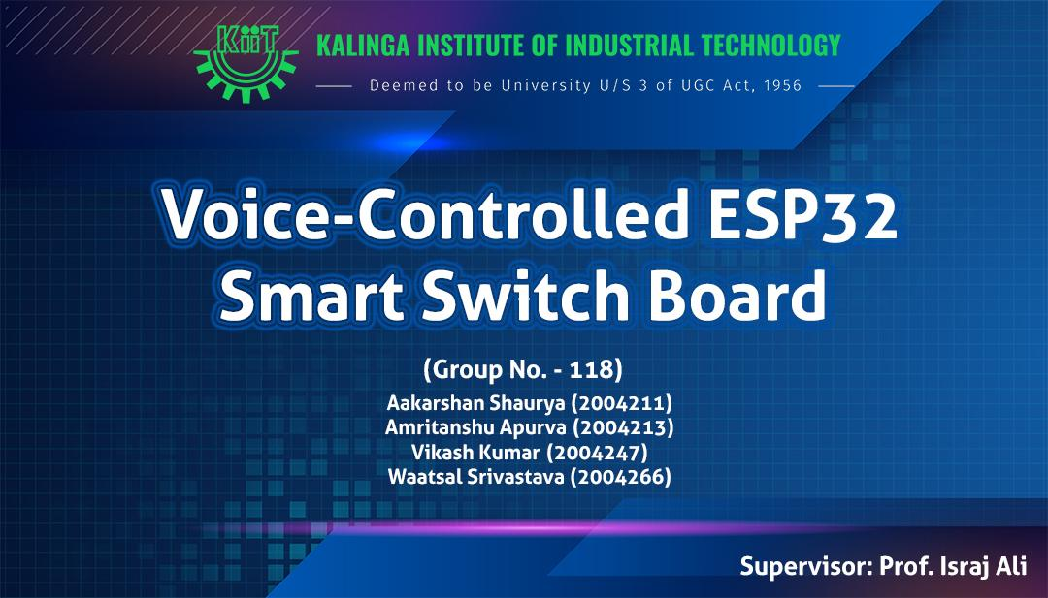

Slide 2

Introduction
Of Project

Slide 3
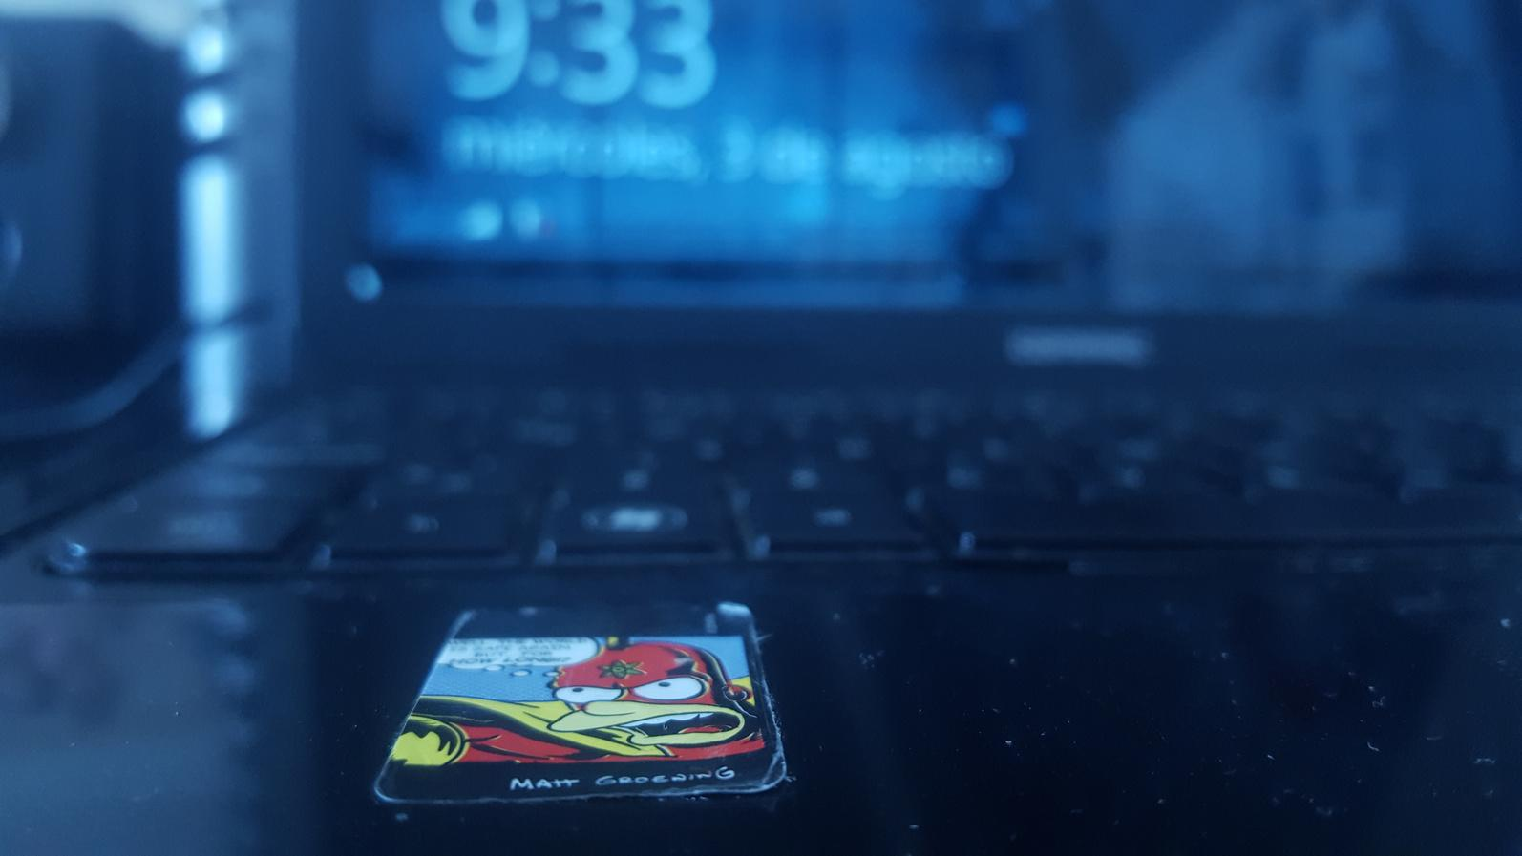

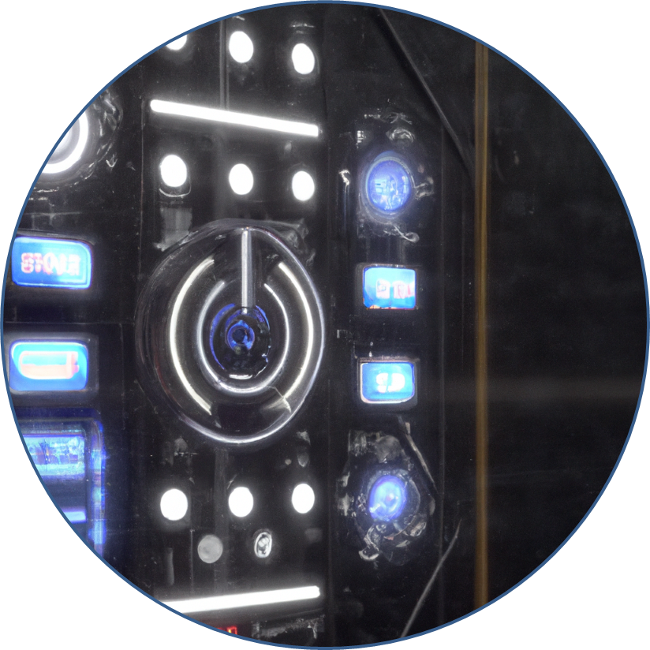

Introduction
Smart homes have become increasingly popular over the past few years. They offer a level of convenience and control that was previously unavailable. Our project is designed to take smart home automation to the next level.
The ESP32 Switch Board is a low-cost, low-power, wireless switch board that can control various electrical devices in the home.
Apart from the convenience and ease-of-use benefits, our project also has social and environmental benefits. By allowing users to control their home appliances remotely, we can help people with mobility issues or disabilities to live more independently. Additionally, our project can also help users reduce their energy consumption and carbon footprint by providing them with better control over their electrical devices.

Slide 4

The novelty of Voice-controlled ESP32 Switch Board with Amazon Alexa/Google Home Integration lies in its ability to integrate two popular voice assistants, Amazon Alexa and Google Home, with an ESP32-based smart switch board.
Novelty
The ESP32 microcontroller is a powerful and low-cost solution that can control a wide range of sensors and actuators, making it an ideal platform for home automation projects. The switch board can be operated through voice commands given by the user as well as on a manual basis without replacing old traditional switch boards.

Slide 5
Objective Of Our Project
Cost Effective
Easy Accessibility
Better Connectivity
The problem in new devices is that they are not user friendly for everyone (esp old age people). So in that case our objective is to fix those things and make it a flexible product that is easily accessible for people of all kinds.
User interface is also not very friendly for everyone on current app in that case our objective is add old traditional switch support to fix those things
The Cost of the current smart Devices is too high and unaffordable for some people. Our objective is to make a product which is cost effective and affordable to everyone.
Without buying new smart devices we are upgrading the old ones and adding smart features thorugh IoT.
If a product is interent dependent and for instance internet availability is poor due to some reasons, so our objective is to add a support like manual control or IR remote in which we can operate those device without internet so the user connectivity increases.

Slide 6
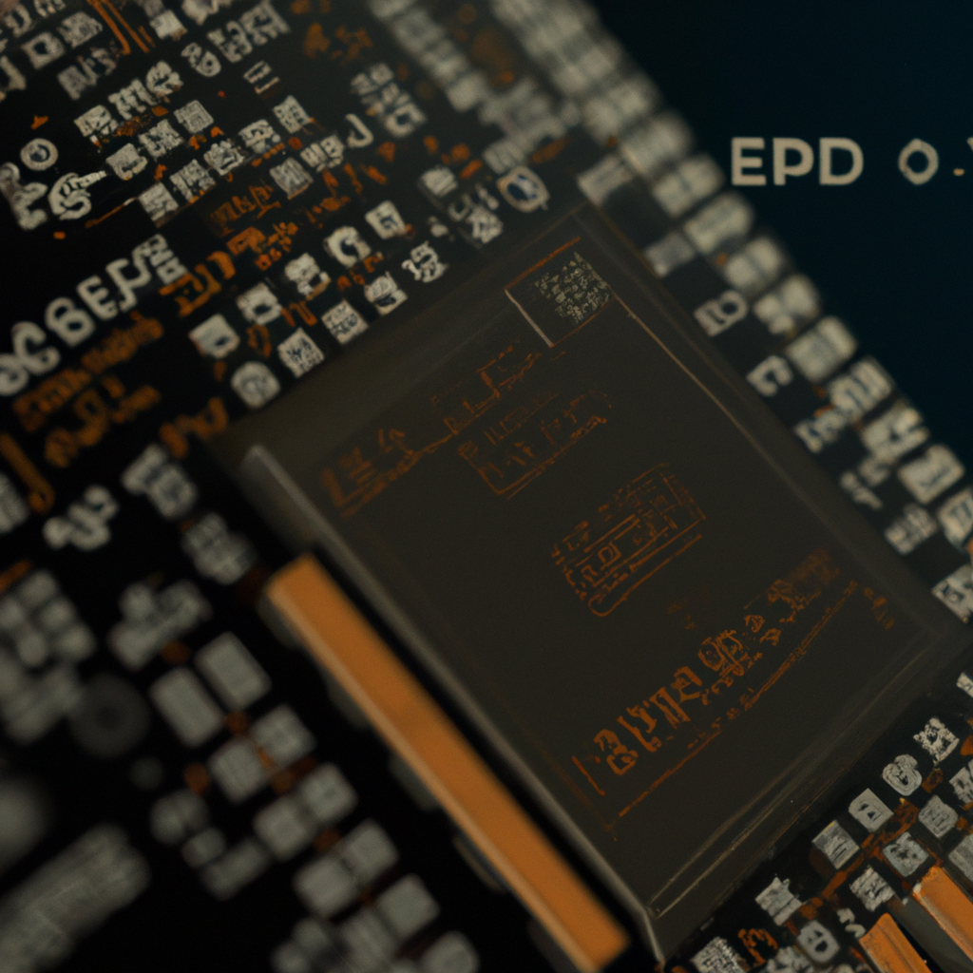
Applied Techniques
ESP32 microcontroller: This is the main hardware component used in the project. It is a low-cost, low-power, and highly versatile microcontroller that can be programmed using C. It has Wi-Fi module through which we can get IoT support.
MQTT protocol: This is a lightweight messaging protocol used to exchange data between devices in the IoT network. It is widely used in ESP Rainmaker projects for its simplicity and low bandwidth requirements.
Alexa/Google Home integration API: This is the application programming interface used to integrate the ESP32 switch board with Alexa and Google Home. The API provides a set of instructions and protocols that allow the devices to communicate with each other.

Slide 7
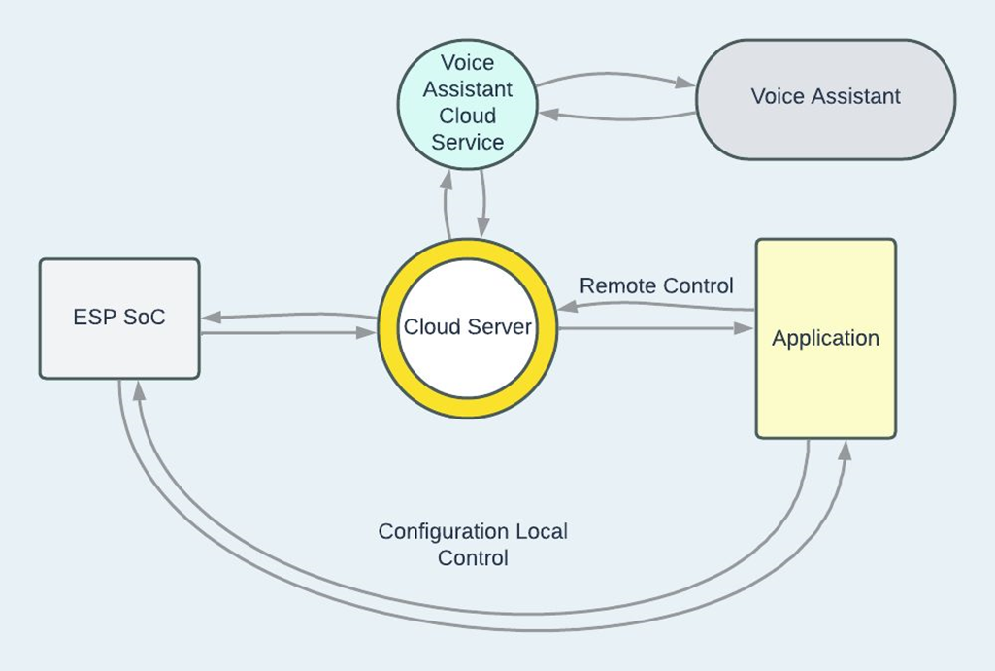
Flow Chart

Slide 8
Tools
ESP 32 Microcontroller We used this to get WiFi access for the project which allows user to control things in online mode so that processor can execute processes offline | 8 Channel Relay We used it to control ac supply that we are getting and with its help we can operate appliances. | 5v Adapter To give power supply to our smart switch board components like relay, Esp 32 and IR remote.
Server It provides integration of popular cloud services like AWS, Google Cloud, and Azure which can be used for data storage, analytics, and visualization. | Bread Board, Jumper wire & IR Breadboard for making temporary connections and jumper wire to make connection and IR for offline control | Electrical Equipment For demonstration of old traditional switchboard and some old components like non smart bulbs

Slide 9

MISSION
VISION
To provide smart home features to everyone.
To provide a user friendly.
Provide these solutions at an effective price.
Easily accessible without any limitation.

Slide 10
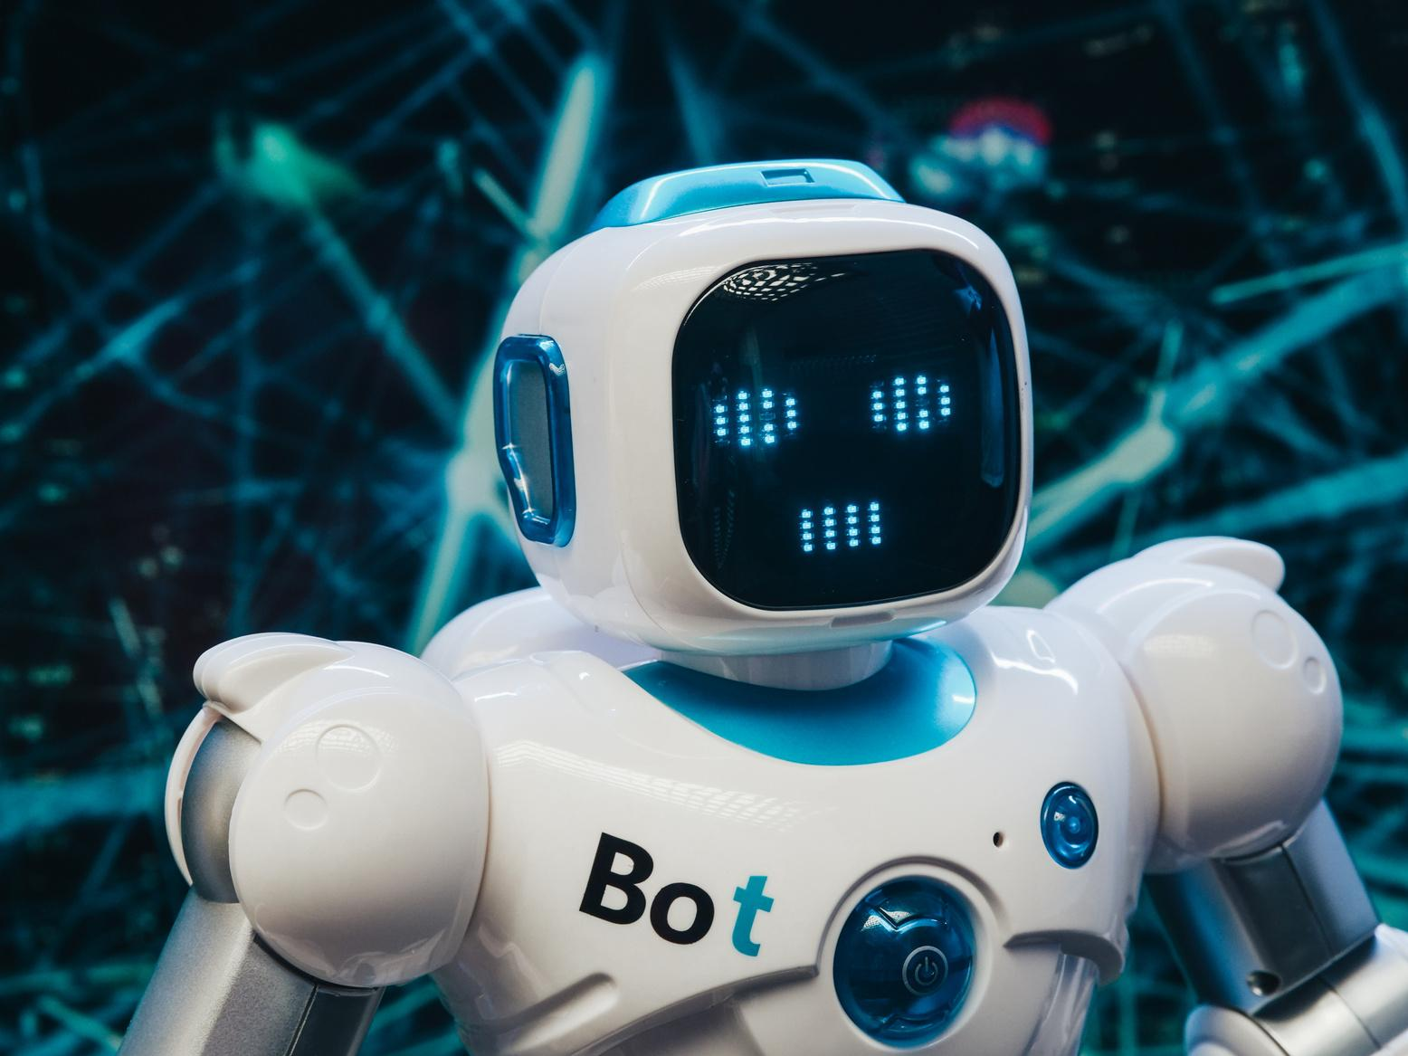
Experiment & Tests

Slide 11

Prototype Testing
1. The experimental demonstration is using Voice Assistants as a pillar for controlling the experiment which makes it easier to operate for people of every age group.
2. To operate the experiment the user needs to give voice instructions to the voice assistant which when detected triggers the responsible relays for that particular operation.
3. The user through this can control the active state of many of the appliances at their homes with an additional feature of regulating fan speeds at the same time.
4. User is also able to control their appliances by giving voice instructions trough mobile applications which also does the same operation in the exact same response time.

Slide 12
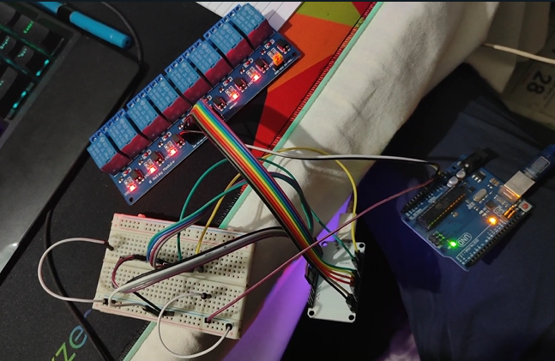
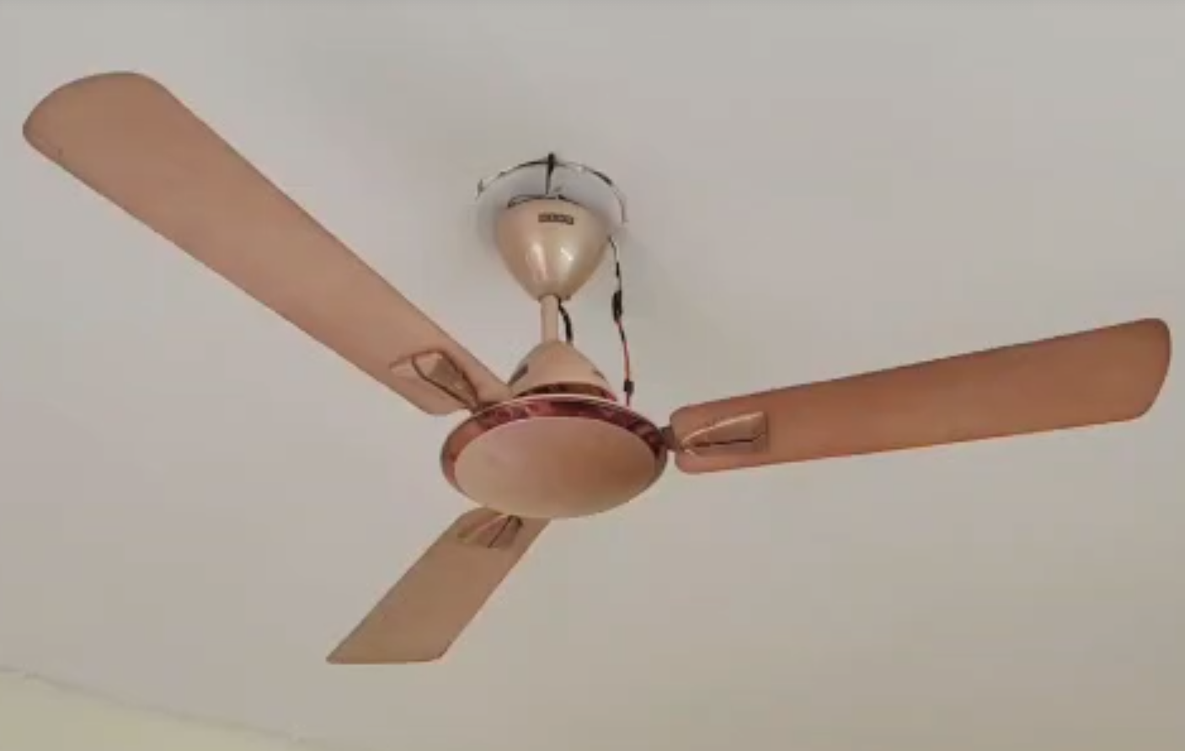
Experiments and Testing
Testing 1
Testing 2
Firstly, the project is tested individually for checking the equipments.
The project is then tested with various fan regulation speeds.

Slide 13
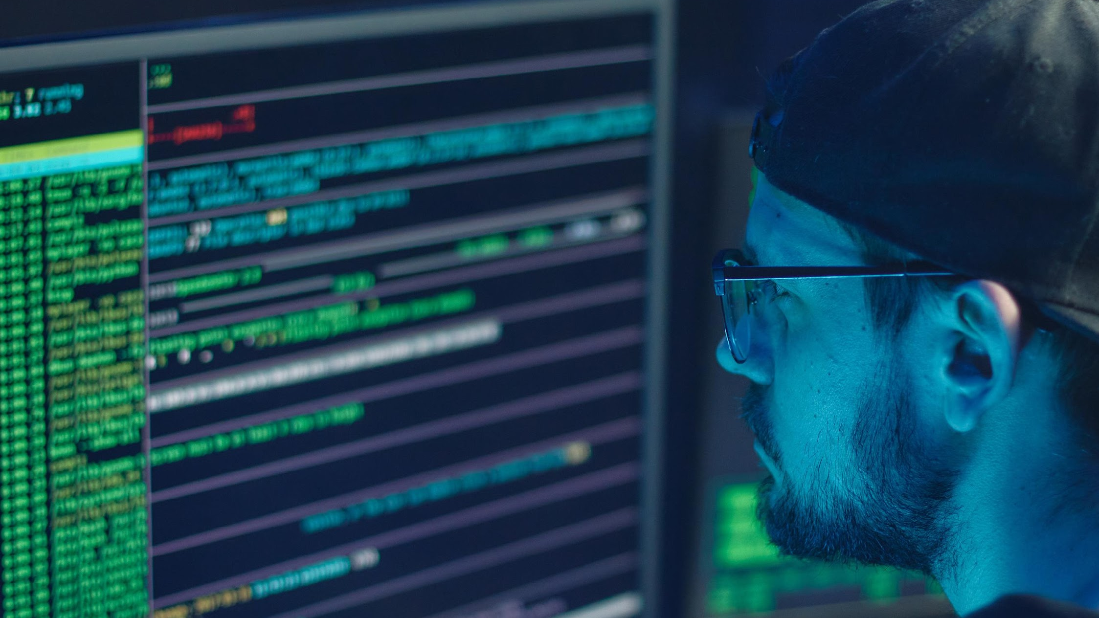
Challenges and Remedy
—

Slide 14
The project was dependent on voice assistant and since everyone cannot afford to install Amazon Alexa or Google Home in their homes, so we gave the project a provision that it can even function without the physical device present. | There might be chances of IP address getting stuck which would make the appliances unfunctional and create issues for the suer in case any important appliance faces this issue. Therefore, we made the project to be allowed to be controlled manually as well which would reduce the inconvenience of the user. | Internet connectivity is a major issue that arises while designing any smart component for a house. Internet connectivity might not always be available in a house maybe due to bad weather or any other factor. This issue has been resolved by providing manual control to the appliances. | Making the project Voice Home Assistant independent, we needed to add a feature which can relay the instructions of the suer to the appliances, this problem was solved by the incorporation of a Cloud Server in our project.
Challenges
Faced
During
Development

Slide 15
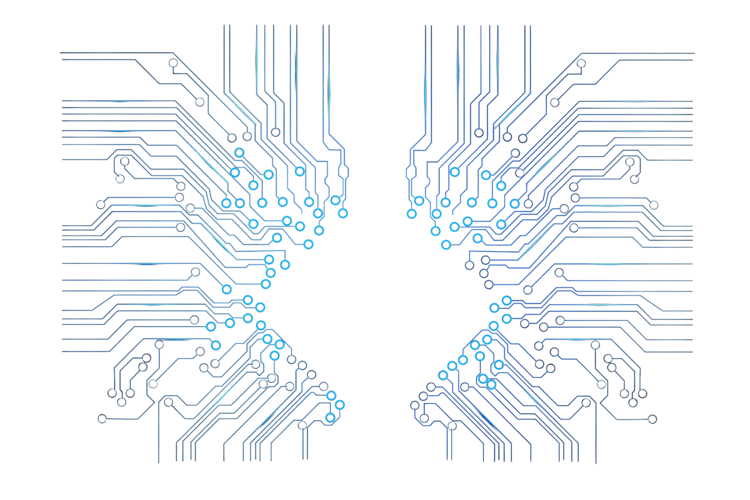

Results & Analysis

Slide 16

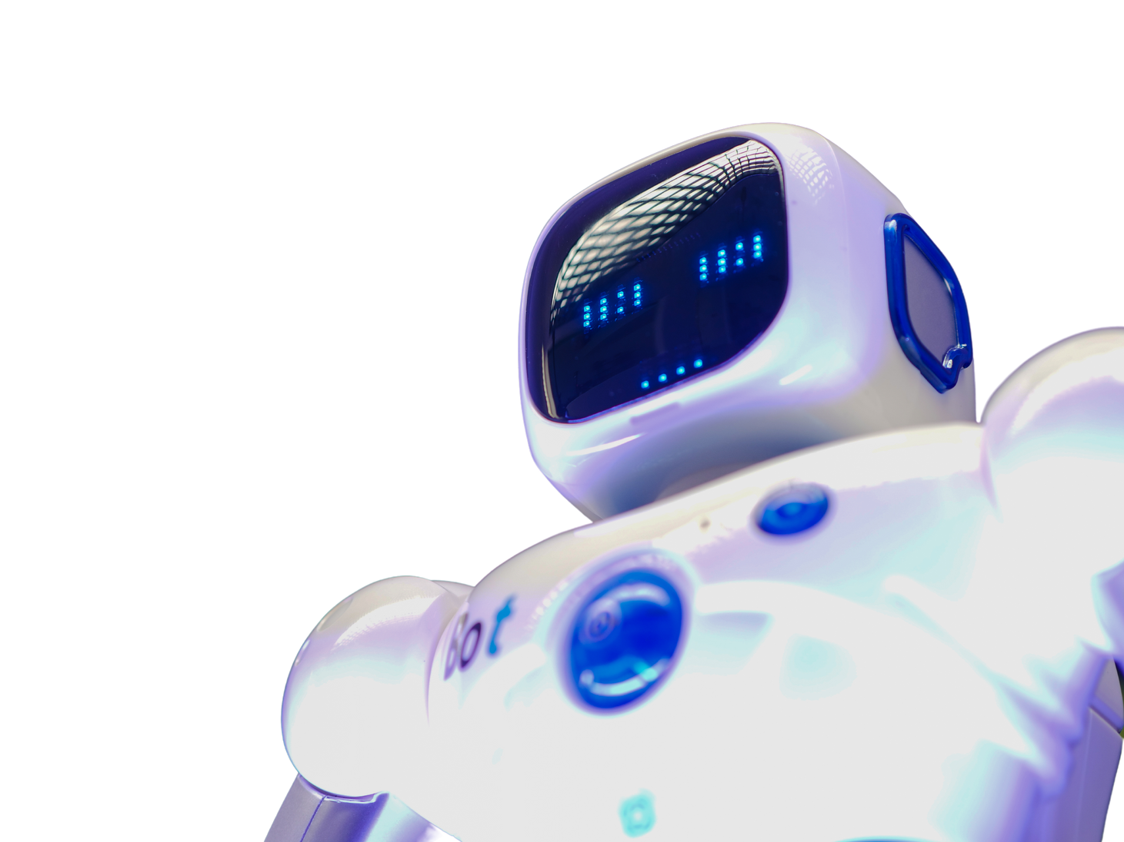
Features
Voice-controlled devices and appliances
The project should enable homeowners to control their devices and appliances using voice commands. This may include devices such as lights, thermostats, security systems, and entertainment systems.
Integration with smart home systems
The project should be able to integrate with other smart home systems, such as Amazon Alexa, Google Home, or Apple HomeKit, to provide a seamless user experience.

Slide 17

Features
Customizable settings and preferences
The project should allow homeowners to customize the settings and preferences of their devices and appliances, such as lighting scenes or temperature presets.
Energy efficiency
The project should optimize the energy usage of a home by allowing homeowners to remotely control and automate their devices and appliances, reducing energy wastage and lowering energy bills.

Slide 18
Overall Progress
The overall progress can be considered positive. The voice-controlled smart home automation system using ESP32 and Alexa/Google Home was successfully implemented, and various tests and experiments were conducted to ensure that the system was functioning as intended.
The project achieved its primary objectives, including the ability to control various home appliances and systems using voice commands, as well as the ability to monitor and receive notifications about home conditions using sensors and the Alexa/Google Home app. The Gantt chart was followed, and progress was made on a monthly basis, with the project being completed within the specified timeline.
However, there were also some limitations and challenges encountered, such as connectivity issues and technical challenges, which required additional troubleshooting and debugging. These challenges were overcome through the application of appropriate methodologies, tools, and techniques, and the final system was found to be stable and reliable.
Overall, the project can be considered a success, with the voice-controlled smart home automation system demonstrating its potential to greatly enhance the convenience and efficiency of home management. The project also provided valuable insights into the challenges and opportunities involved in the development of home automation systems, which will be useful in future research and development efforts in this area.

Slide 19
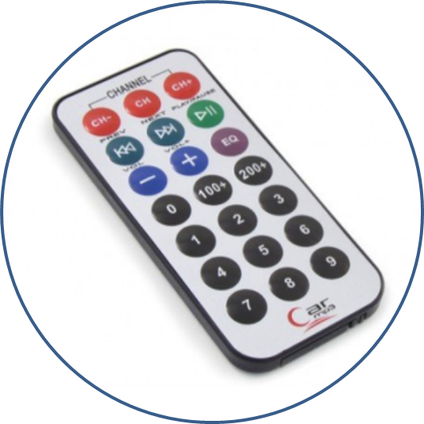
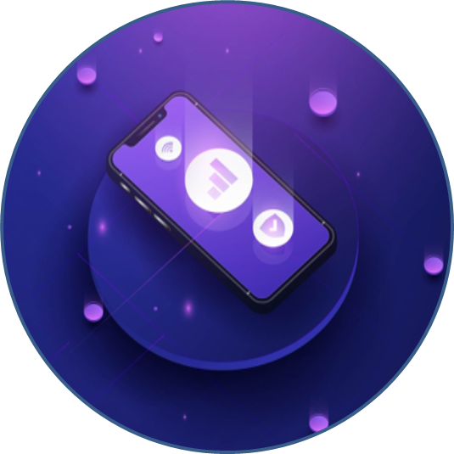
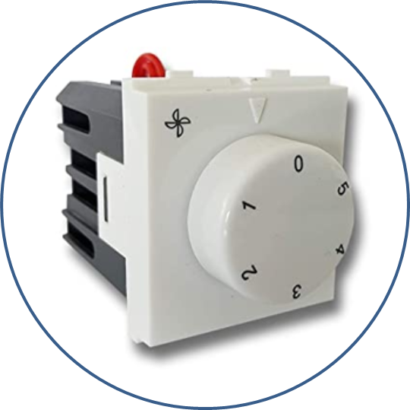
Further Plane of Action
Fan regulator
IR remote Support
Mobile App
Implementing manual fan regulation option with SmartThings.
Addition of IR remote support for enabling offline and manual control.
Adding mobile application support that does not depend on APIs like google and alexa.

Slide 20
THANK YOU!

